Slide 1
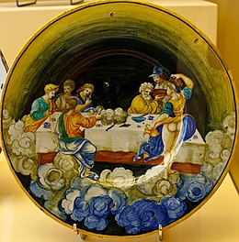
Low Latency Microservices Using Ambrosia
The Food of the Gods on Olympus (1530), majolica dish attributed to Nicola da Urbino

Slide 2


Slide 3

Ambrosia

Slide 4


Slide 5


Slide 6


You will transform your monolith into a shiny new Java microservices low latency system and have it deployed this year or you will fail your year end review…..

Slide 7


Do not fear just go to Ambrosia Wizard and he will sort out your project.
But where is he?
In the Microservices Competency Centre – just follow that yellow brick road and you’ll be there in no time.

Slide 8

Our heroine couldn’t take this task on all alone so presently….

Slide 9

The straw developer wanted to help but he had no brains “I can’t do a low latency application especially not in Java”

Slide 10

The tin developer wanted to be part of the team but alas he had no heart “I can’t take on replication failover and inter-pod communication”

Slide 11

The lion developer too wanted to be part of this new initiative but he had no courage “I can’t take on microservices I’ve only ever developed a monolith before – I don’t know where I am without Spring “ he shuddered…

Slide 12

At last they arrived at the Microservices Competency Centre…
We hear there’s a wizard here and we need magic to help us….

Slide 13
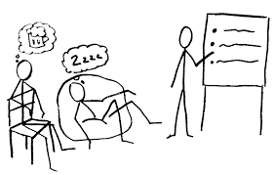
But sadly there was no wizard just a bunch of rather aging boring developers… with no magic powers at all but they were aware of Arther C Clarke’s law that…
Any sufficiently advanced technology is indistinguishable from magic

Slide 14

So once the developers gave them Ambrosia they had everything they needed, the scarecrow dev got to develop low latency, the tin developer got networking and the lion got microservices and Dorothy delivered her project on time.

Slide 15

and at the next review Dorothy got promoted to Managing Director

Slide 16
The Control Continuum Trade Off
CONTROL
FPGA/Assembly
C/C++
Java
HTML
Admin rights
Security
Low latency
Libraries
Frameworks
Creativity
Frustration
Code reuse
Micro Services
Code quality
Start Up
Investment bank
Air traffic control
Productivity
Ease of Development

Slide 17
What is the Ambrosia framework?
Java
Ultra Low Latency
Ambrosia
Micro Services

Slide 18
Introduction - Timescales
1/1000s = millisecond (ms)
1/1000,000s = microsecond (us)
1/1000,000,000 = nanosecond (ns)
Light travels 1 foot (30 cm) / nanosecond. In a vacuum - slower through fibre optic cable. London to New York 10’s of milliseconds.
CPU running at 4GHz can perform 4 cycles per ns. Given the parallelism of the CPU and multiple cores you might be able to get 100+ cycles of compute power in the time light has travelled a foot. Speed of light starts to matter...
In Neutrino physics the characteristic areas for the electroweak interaction are measured in units called nano barns (nb) which are 10−33
Notes:
Speed of light 8 minutes to get to the sun
That’s 100 adds or 2 divide operations (which is why you shouldn’t use divide or modulus) but that’s another story

Slide 19
Java and Ultra Low Latency
Is Java a suitable technology for ultra low latency dev environments?
Depends how you define ultra low latency….
‘Ultra’ low latency programming -> < 100us and when you care about the 99.99th percentile.
Low latency is often associated with but is not the same as high throughput!!!
Notes:
Speed of light 8 minutes to get to the sun
That’s 100 adds or 2 divide operations (which is why you shouldn’t use divide or modulus) but that’s another story

Slide 20
InfinityCable
InfinityCable is a DMA (Direct Market Access) system developed in Citi using Ambrosia microservices.
It receives a fix message from the client which is parsed, some risk checks are applied to it, there is some order management effected before it needs to be transformed back into a fix message and sent to the venue in an architecture that looks like this.
Client decodes fix and adds market data
ORA performs risk checks and order management
Venue recreates the fix message and sends to the exchange
Fix In
Fix Out
On our fastest boxes in the lab we have the time measured on Corvil at 11us at the 50th %ile (see full stats in the next slide)
The time for a smallish message to transfer between microservices including serialisation and deserialization should be well under 1us.

Slide 21
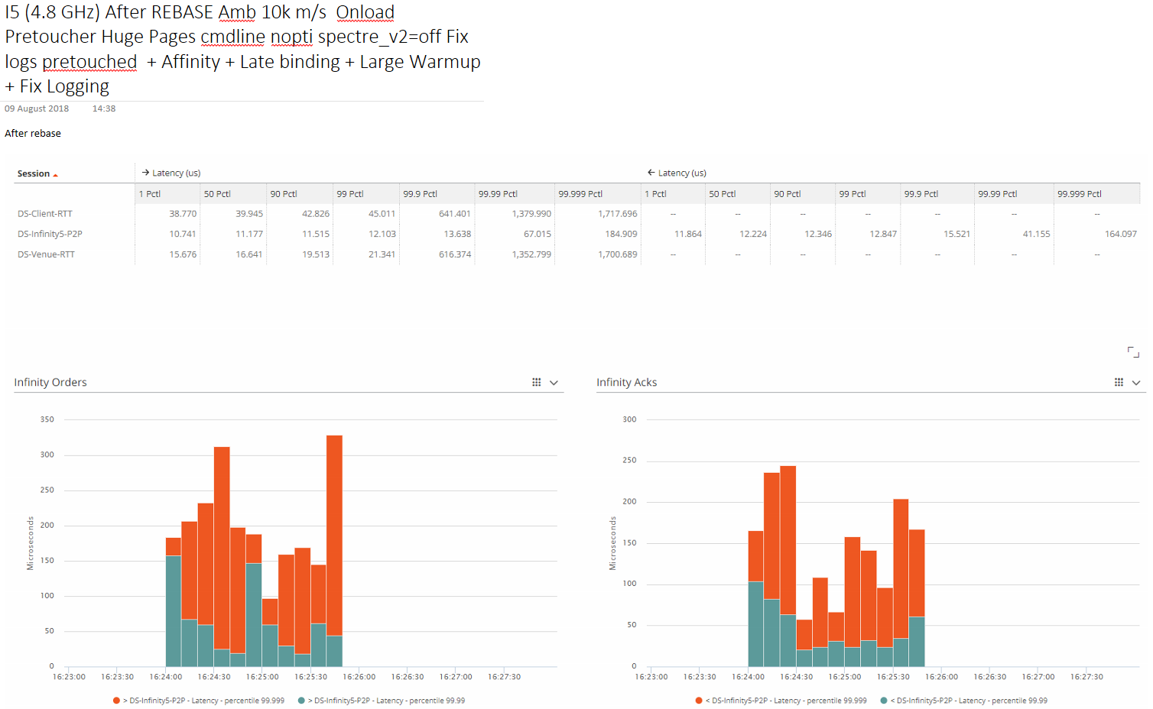
Full benchmark stats

Slide 22
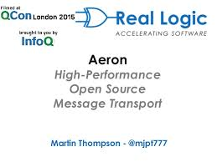
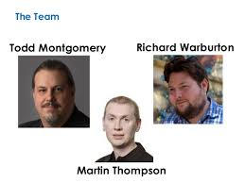
The Aeron Story
Aeron first written in Java
Ported to C++ / C# / Go
At first Java was fastest
After some optimisations C# fastest
With a lot of effort C++ became the fastest
But where should we spend out time

Slide 23
Challenges of using Java
Garbage collection
Warmup
Unpredictable compilation
No value types (C structs) - don’t have control of the memory layout
Unnatural programming to get low level constructs (Unsafe)
Certain CPU instructions are not available
Notes:
Garbage collection - elipson but we like GC until the critical section does it add overhead when not running. Safe points.
But Java has many advantages.

Slide 24
Summary
Java is a reasonable choice for low latency environments.
Ambrosia takes care of making garbage free programming the natural style.
Ambrosia hides away the complexity of writing to off heap shared memory, pinning threads to cores, provides tools for code warm up which are not natural in Java.
To achieve order of magnitude improvements in latency you need to move into hardware not another language. e.g. C/C++.
Notes:
Garbage collection - elipson but we like GC until the critical section does it add overhead when not running. Safe points.
But Java has many advantages.

Slide 25
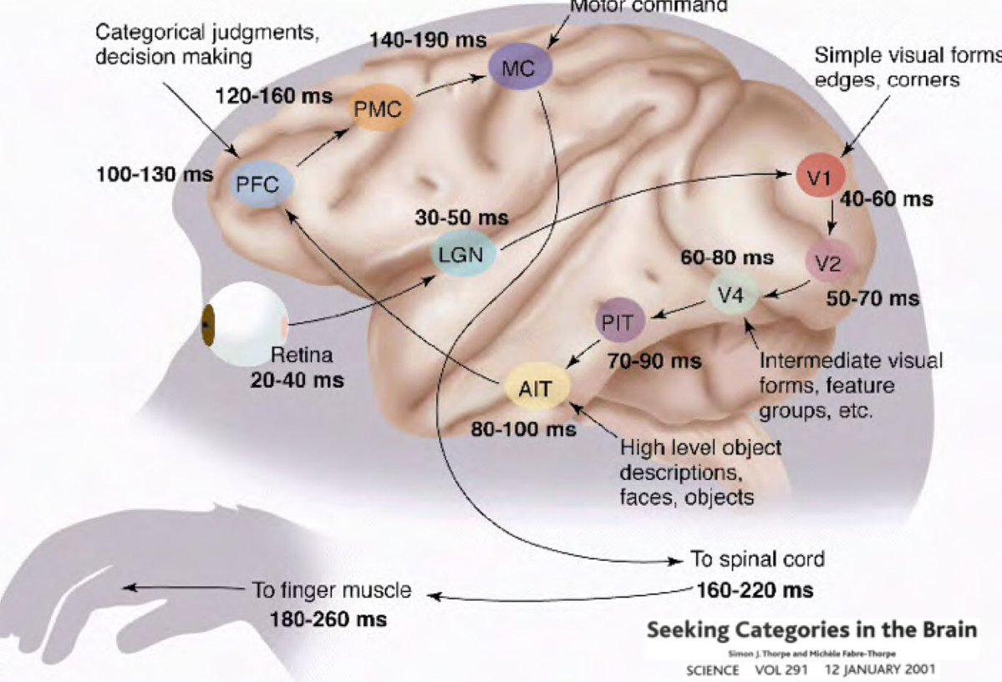
Microservices and Ultra Low Latency
Notes:
Garbage collection - elipson but we like GC until the critical section does it add overhead when not running. Safe points.
But Java has many advantages.

Slide 26
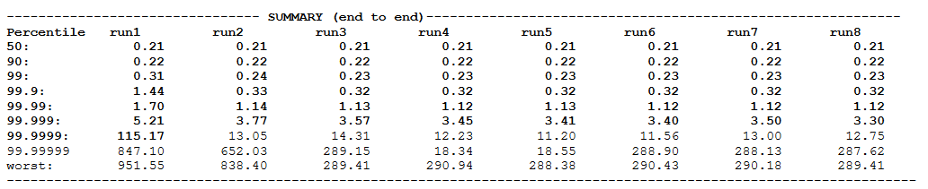
Are microservices slow?
Message passing through TCP and REST is slow (10us)
But what about message passing using shared memory (100ns @ 50th percentile)
Notes:
Garbage collection - elipson but we like GC until the critical section does it add overhead when not running. Safe points.
But Java has many advantages.

Slide 27
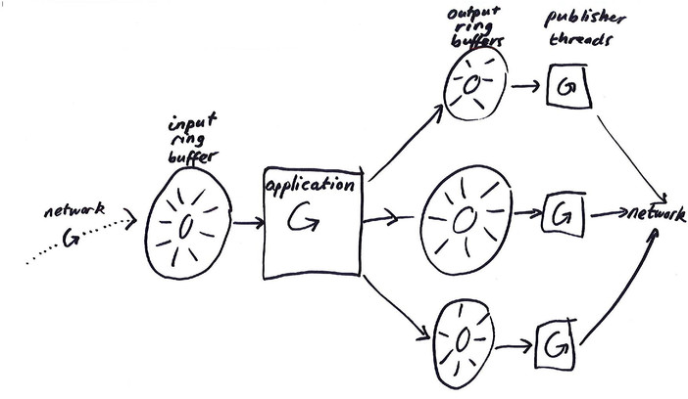
Typical multithreaded systems
Notes:
Garbage collection - elipson but we like GC until the critical section does it add overhead when not running. Safe points.
But Java has many advantages.

Slide 28
Problems with typical systems
Need to write thread safe code
Often the code is not lock free let alone wait free
Very hard to make garbage free without complex thread pools
By definition the code becomes very hard to reason about
They put pressure on the JVM safe pointing GC compilation etc
They are not deterministic in terms of replay
They are hard to test
They are no more efficient on hardware still need a core per thread
The real problems come when trying to diagnose latency in the higher percentiles
Notes:
Garbage collection - elipson but we like GC until the critical section does it add overhead when not running. Safe points.
But Java has many advantages.

Slide 29
The Ambrosia single threaded event loop
The event loop provides the pulse for the service. As well as reading inputs from queues as a trigger for work, timers and service tasks can be added to it to keep the all tasks in the service single threaded.
The event loop can be called in busy (spinning mode) or in various sleepy modes depending on how much CPU is available to the service.
Data in 1
Timer: call back every 5 seconds
Microservice
Data in 2
Service task: check for data on a socket
Data out

Slide 30
Conceptually the event loop cycle can be thought of like a funnel
Queue Inputs
Timers
Tasks
Event Loop
Microservice

Slide 31

Hog the CPU - and CPU pin
Notes:
Maximise the use of your CPU

Slide 32
Ambrosia Serialisation
001011110000000010
ServiceDTO
setId()
getId()
setPrice()
getPrice()
001011110000000010
Microservices communicate with each other by writing messages to queues stored in shared memory accessible to the pod.
One of the key features in Ambrosia is the efficient manner in which it serialises or marshals data from shared memory to and from the service where it appears to the service as a POJO. All the developer has to do is use the Java @ServiceDTO annotation on a class and this will happen automagically, we will see this in the code shortly.

Slide 33

A micro services catalogue
Microservices vs drop in libraries
Notes:
Garbage collection - elipson but we like GC until the critical section does it add overhead when not running. Safe points.
But Java has many advantages.

Slide 34
Citi libraries plug and play Low Latency Microservices at Citi
The aim is to build up a catalogue of useful components within Citi. Here are some services that already exist.
Reference data microservices
Market data microservices
KDB microservice
DNA microservice
Tibco bridge microservices
Fix gateway microservice
Exergy market data microservice

Slide 35
What else do the microservices need
Inter-pod coordination e.g. when to become active
Communication between machines
Failover and recovery
Notes:
Garbage collection - elipson but we like GC until the critical section does it add overhead when not running. Safe points.
But Java has many advantages.

Slide 36
Ambrosia Replication
MS1
MS2
PodA is active and is the sender of messages
The TCPReplicationService is used to replicate the output queues from MS1 and MS2 from PodA to PodB.
Note that MS1 and MS2 on PodB will be running in recovery and having the messages played in to them as such.
ReplicationService
TCP/IP
ReplicationService
PodB is passive and is the receiver of messages
MS1
MS2

Slide 37
Ambrosia microservices - definitions
Podmaster
Podmaster
Microservices (small boxes) communicate with each other via queues (arrows).
Groups of microservices are called pods and live on single server. You can have more than one pod on a big server.
Each pod may have a podmaster.
Pods can communicate with each other through their podmasters.
Pods can share data with each other using replication or bridge communication (more of that later).
MS
MS
MS
MS
MS
MS
MS
MS
MS
MS
MS
MS
MS
MS
Podmaster
MS
MS
MS
MS
MS
MS
MS

Slide 38
Ambrosia microservices components
ambrosia-bom
core-foundation
microservices-core |  | microservices-logger |  |  |  | core-tcp
podmaster
microservices-replication |  |  |  | microservices-bridge
core-gateway | core-marketdata |  | core-dna |  | core-exergy |  | core-reference-data
Chronicle-FIX
microservices-demo
your-project

Slide 39
Summary Microservices
They can be very fast indeed – ultra low latency (in our definition)
More testable maintainable separable code
Organisational benefit as decoupling code via the queue creates well defined contracts between services (and the teams supporting and maintaining them).
Notes:
Garbage collection - elipson but we like GC until the critical section does it add overhead when not running. Safe points.
But Java has many advantages.

Slide 40
Further reading Low Latency Microservices at Citi
Microservices Competency Centre https://icgshare.eur.citi.net/sites/CELT/SitePages/Microservices%20Competency%20Centre.aspx
Ambrosia Wiki
https://cedt-confluence.nam.nsroot.net/confluence/pages/viewpage.action?spaceKey=Chronology&title=Ambrosia+Microservices

